Slide 1


MUNICHTECH EXPO 2026
MunichTech EXPO 2026 Operations & AI Workflow Coordination Proposal
Scalable Execution Meets Intelligent Automation
Prepared By:
Eronmosele Austin Oboh
www.munichtechexpo.com

Slide 2

Executive Summary
Strategic Focus:
Integrated Approach:
Operational strategy centered on scalable execution and AI-supported workflows
Combines operations, automation, communication, and ecosystem management
Core Goals:
AI Integration:
Improve attendee experience, enhance operational visibility, maximize workflow efficiency
Leveraging intelligent automation for real-time coordination and decision support

Slide 3
Event Operations Structure
Registration & Ticketing:
Speaker Coordination:
End-to-end ticket management, QR code generation, check-in systems, and badge printing
Invitation workflows, session scheduling, AV requirements, and live presentation support
Sponsor & Exhibitor Ops:
Venue & Logistics:
Agreement processing, branding delivery, booth setup coordination, and activation support
Facility management, equipment setup, signage, catering, and volunteer deployment

Slide 4


Core Operational Workflows
Attendee Journey:
Ticket → QR Code → Check-In → Badge → Sessions
Critical Event Processes
Speaker Workflow:
Invitation → Confirmation → Session → Live Support
Sponsor Workflow:
Agreement → Branding → Booth Setup → Activation
Incident Escalation:
Issue Detection → Operations Lead → Resolution

Slide 5
Operational Timeline
90 Days Before:
30 Days Before:
Event & Post:
Venue planning and logistics coordination.
Sponsor outreach and partnership
agreements. Speaker onboarding and
session planning.
Agenda finalization and schedule lock.
Volunteer recruitment and
training. Testing systems and
operational briefings.
Live execution and escalation
management.
Real-time monitoring and
incident response. Post-event reporting,
analytics, and sponsor follow-up.

Slide 6
AI Workflow & Automation Concepts
AI Sponsor Onboarding:
AI Speaker Follow-Up:
Automated welcome sequences, document collection, and branding asset coordination for sponsors
Intelligent reminders for session confirmations, bio submissions, and presentation uploads
AI Matchmaking:
AI Chatbot & Summaries:
Smart attendee recommendations based on interests, industry, and networking goals
24/7 FAQ support and AI-generated operational reports for real-time insights

Slide 7


Hackathon Coordination Logic
Participant Scale:
100 participants organized across 20 competitive teams with dedicated mentor and judge coordination
AI Team Formation:
AI-assisted team matching based on skills, interests, and experience levels for optimal collaboration
Real-Time Communication:
Integrated Slack and Discord channels for instant updates, mentor support, and team coordination

Slide 8
Operations Dashboard Concept
Sponsor & Speaker Tracking
Ticket Sales Monitoring
Real-time monitoring of sponsor onboarding status, exhibitor booth assignments, and speaker confirmations
Live dashboards tracking ticket sales velocity, attendee growth trends, and registration analytics
Task Management
Incident Escalation Monitoring
Centralized deadline tracking and task coordination using Notion and Airtable workflows
Live operations monitoring with Power BI for rapid issue detection and resolution tracking

Slide 9

Crisis Scenario Management
Volunteer Coordination:
Address breakdown scenarios with backup pools and rapid redeployment protocols.
Emergency Response Protocol
Registration Spike Handling:
Stabilize surges with extra check-in capacity and overflow queue management.
Backup Speaker Activation:
Maintain standby speaker roster for rapid session replacement.
Sponsor Issue Resolution:
Rapid escalation pathways to resolve branding and booth concerns.
Calm Communication:
Maintain operational visibility with clear team updates.

Slide 10

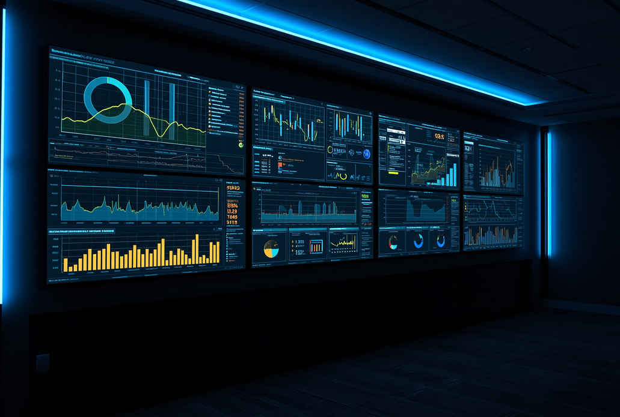
AI Operations Command Center
Live KPI Dashboards:
Real-time tracking of attendee flow, ticket sales, and operational metrics across all event zones
Predictive Management:
Integrated Workflows:
AI-powered crowd analytics and risk forecasting to prevent bottlenecks and safety issues
Automated operational summaries, alerts, and seamless system integration across platforms

Slide 11

Conclusion
Summary & Key Takeaways
Operational Excellence:
AI-Powered Innovation:
This proposal demonstrates comprehensive
operational thinking with scalable
coordination frameworks design
for MunichTech EXPO 2026's complexity.
Combines business operations with AI-supported workflow optimization for enhanced efficiency.
Focuses on practical execution, clear communication, and operational maturity throughout.

Slide 12

MUNICHTECH EXPO 2026
Thank You For Your Attention
Questions? Let's discuss the future of MunichTech EXPO 2026
Contact:
Eronmosele Austin Oboh
austinoboh94@gmail.com

